Slide 1
ECE 590 Software Engineering for Embedded Applications
Week 1: Git, Docker, Gnu compiler, Make, Doxygen, Google Test
Prof. Eric Klavins
Kung-Hung (Henry) Lu, TA
Justin Vrana, TA

Slide 2
Course Goals: You will learn
To build reusable code in C, C++ and similar languages.
Data structures and algorithms relevant to embedded systems programming.
Software engineering methods such as unit testing, containerized environments, agile development.
Network computing.
Cloud computing.

Slide 3
Course Structure
Thursdays 6-9pm
1.5 hours lecture
1.5 hours hands on coding
Homework
assigned every Thursday. Due the on Friday eight days later.
turned in via Github. We clone your code and run unit tests.
Last homework is (somewhat) open ended project.
To be done on your own. You may not copy or otherwise incorporate other people’s code into your own. Discussing strategies and ideas is ok.
In class computer work: Course content only!
Office hours:
Eric: Thursdays 5-6 pm in CSE 236, starting 1/17.
TAs: Saturday 10-12am, Place TBA
Monday 6-9pm, Google Hangout
Discussions: on Canvas

Slide 4
Introduction
First computer: Atari 800 in 1979, Basic and Assembly
BM in Music, SFSU 1991
BS in CS, SFSU 1996.
PhD in CSE, U. Michigan 2001. Thesis: Decentralized Regulation of Cyclic Robotic Systems
Postdoc in Control Systems, Caltech 2003: Programming Dynamic Robots.
Professor since 2003: Robotics, automation, genetic engineering, synthetic biology.
Programming projects of note
Childhood: 8-bit video games
COW: 1990s online conferencing system
Grad school: Operating systems, compilers
RHex Robot Operating System
CCL: Control systems programming language
gro: Multicellular design and simulation software
Aquarium: Laboratory Operating System
Hobbies: Music, rock climbing, coding, cubing.

Slide 5
Introductions
Introduce yourself to your neighbor

Slide 6
Today
Editors
Git
Docker
Unix
Compiling code
Compiling documentation
Basic unit testing

Slide 7
Visual Studio Code
A very good editor for the C and C++ code we will write.
Free: https://code.visualstudio.com/
Has
Syntax highlighting
Autocomplete
Extensions
Other editors we like: Atom, Sublime.
You might like vim, emacs – but we expect you know how to use them.
Avoid: Xcode, Visual Studio, etc.

Slide 8
Git and Github
Git is a version control system.
Git should be easy to install on any OS
Go to Github and make a new repo called ECE590 (with no README)
mkdir ECE590
touch README.md
git init
git add .
git commit -m "first commit”
git remote add origin https://github.com/yourusername/ECE590.git
git push -u origin master
// edit and/or add some files
git add .
git commit -m “Changed some files”
git push origin master
Go back to Github to see your changes
Your student account should give you the ability to make private repos (so other students will not see your code)
Consider using Github Desktop!
Repeat as needed

Slide 9
Demo
Clone a repo
Get the course code: https://github.com/klavins/ECEP520
Make a change
Commit and push it
Make a new repo
Go to github
Follow instructions

Slide 10
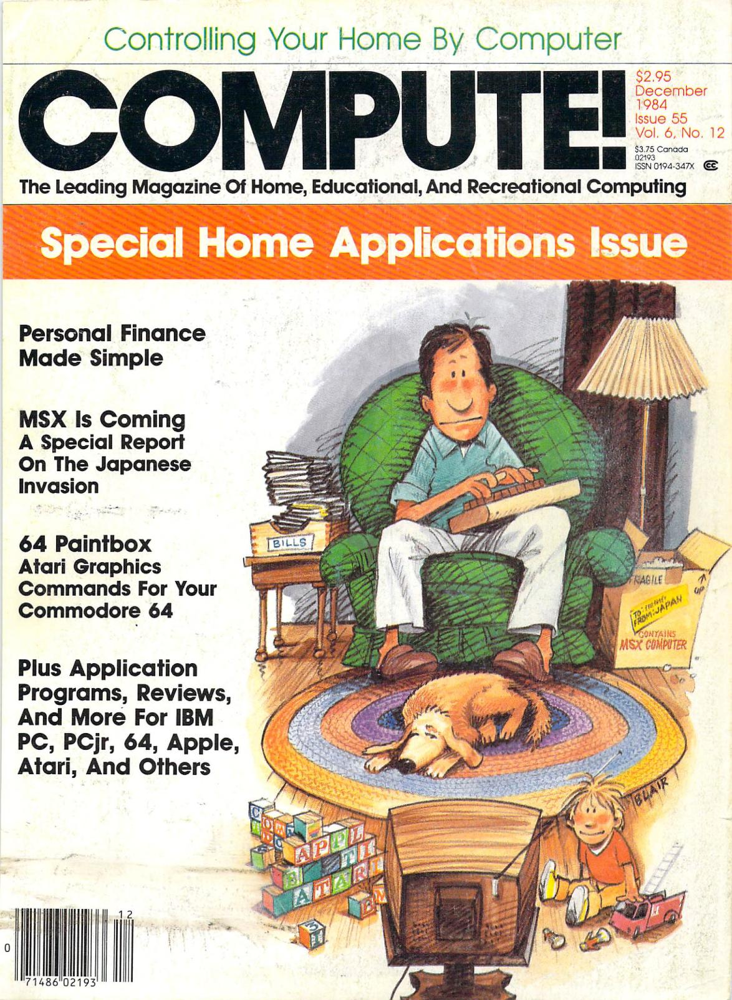
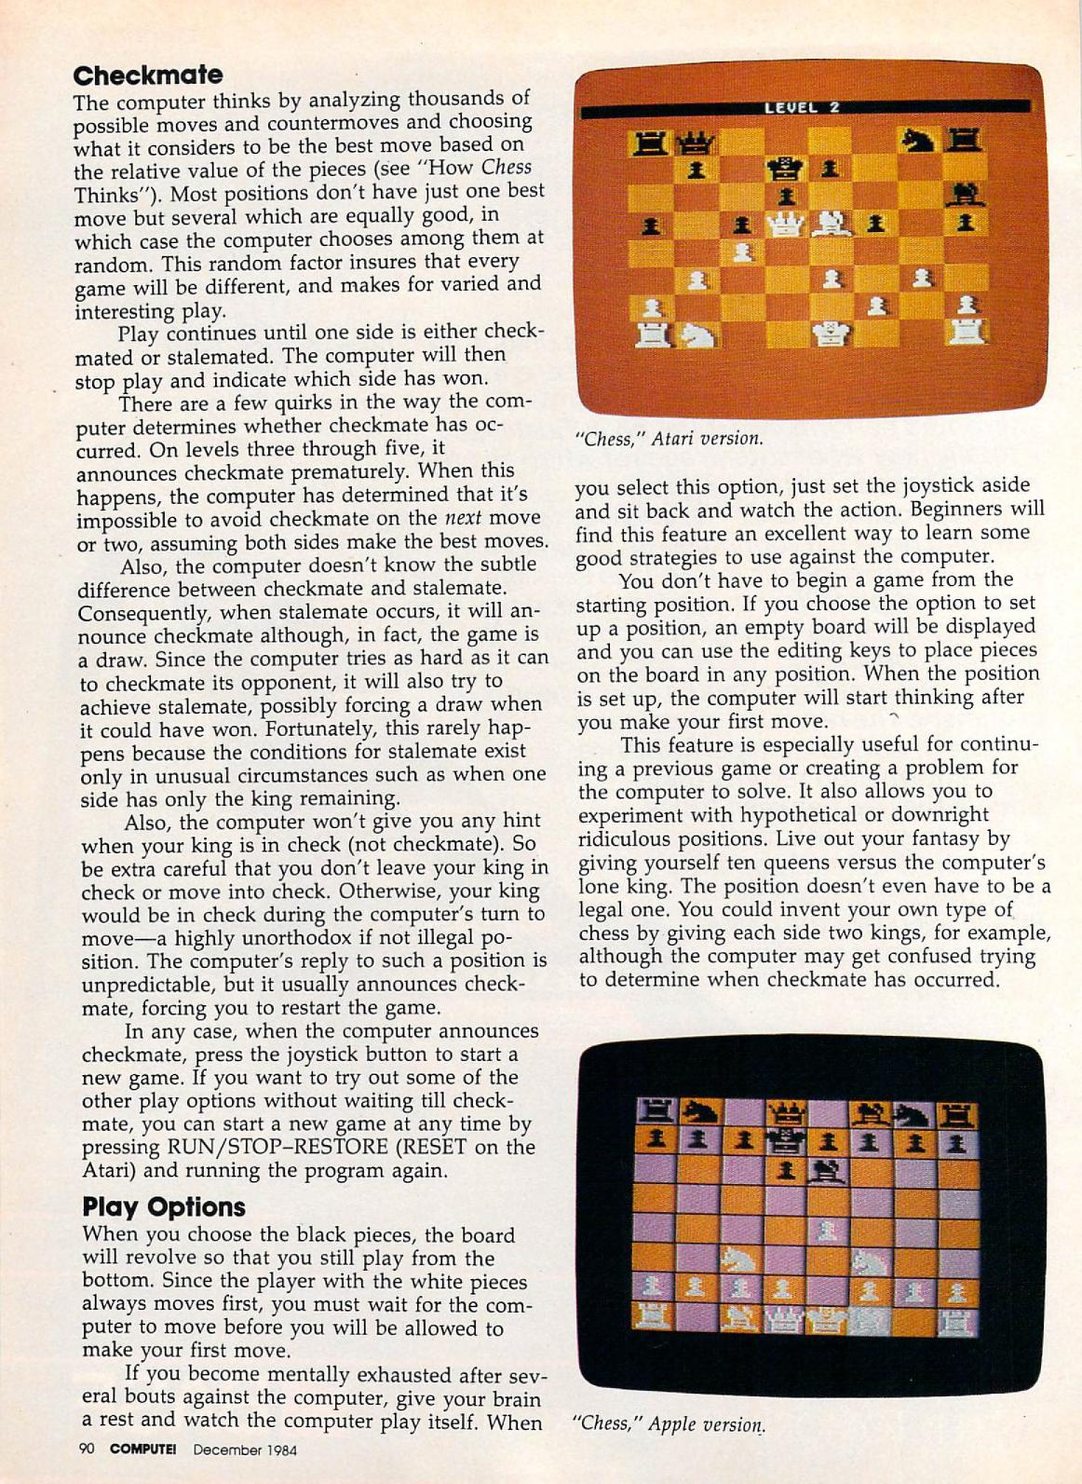
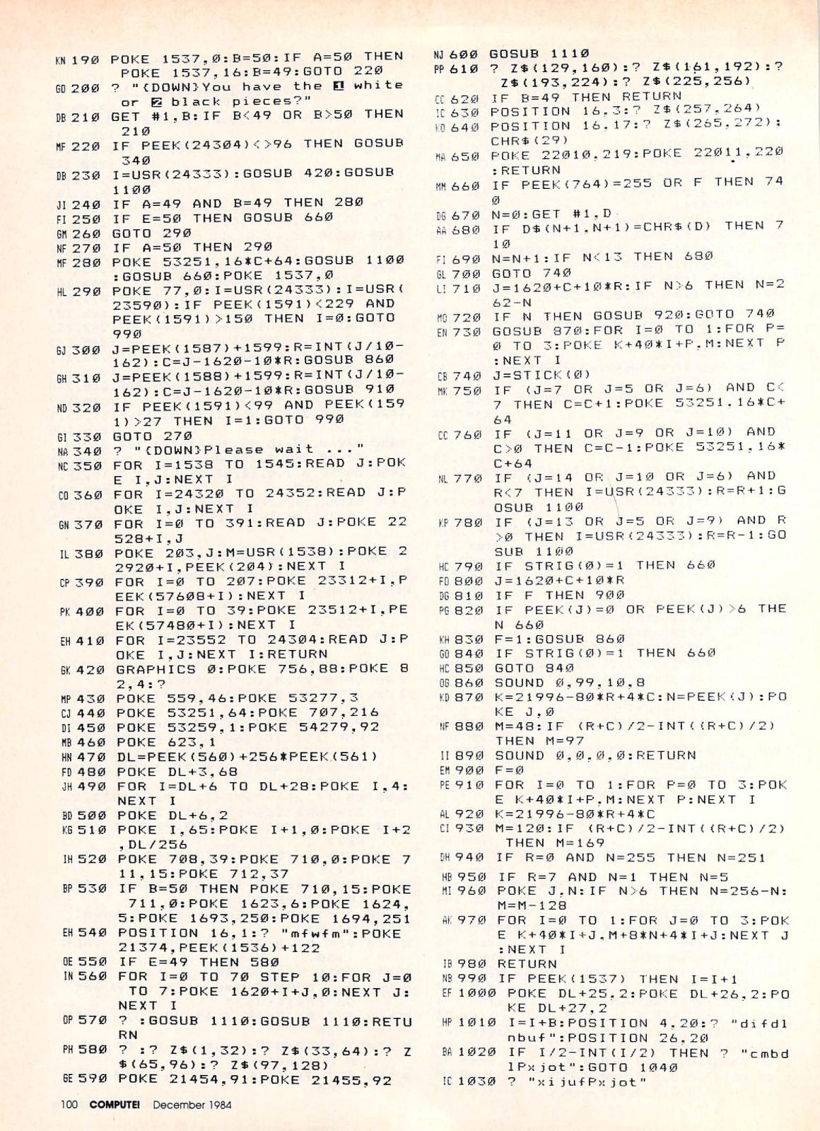

Slide 11
How we will use git
We will assign exercises each week.
Put the code for exercises in, for example, ECE590/hw_1.
We will clone your repo on Fridays at midnight (or there about).
For C and C++ exercises, we will replace unit_test.c with our own unit_test.c and recompile your code. We will put our scripts up on Github (leaving out some details) for you to use test your code.
It is important to name your functions and classes exactly as we specify so that the tests will compile.

Slide 12
Docker
Problem:
You all run various versions of Windows, Mac OS, and Linux.
We need a common environment.
So does any company that develops software.
Production environment should match development environment.
The solution: Docker
Let’s you define a unix environment with exactly the pre-requisites your code needs.

Slide 13
Unix

Slide 15
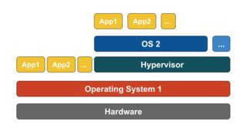
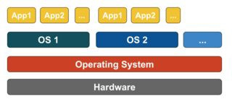
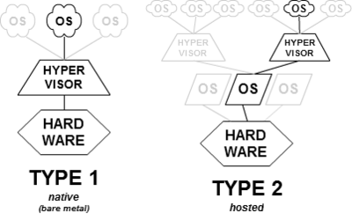
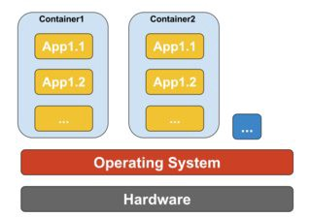
Virtualization
Emulation
(e.g. VMware)
Requires Virtualization (e.g. Intel, AMD, ARM and MIPS)
On Linux, Docker uses the same kernel, but with a different namespace and filesystem.
On Mac, Docker uses xhyve, a hypervisor that creates a completely sandboxed kernel space.
On Windows, Docker uses Hyper-V. Also gives you a Unix like command shell.
Paravirtualization
(e.g. xhyve, Hyper-V)
Virtualization
(e.g. Linux namespaces)

Slide 16
Union File Systems
Linux’s Union Mount filesystem
/dir1
- afile.c
- afile.h
/dir1
- afile.c
/dir2
-another.h
/dir1
- afile.c
- afile.h
/dir2
-another.h
U
=
Docker images contain filesystems.
Union a number of filesystems gives you a new filesystem.

Slide 17
Example Dockerfile
FROM gcc:4.9
RUN apt-get update && \
apt-get install -y cmake && \
apt-get install -y cppcheck && \
apt-get install -y graphviz && \
apt-get install -y doxygen && \
apt-get install -y nano
# Build google test
WORKDIR /usr/src
RUN git clone https://github.com/google/googletest.git
WORKDIR /usr/src/googletest/install
RUN cmake ../ && make && make install
WORKDIR /source
COPY bashrc /root/.bashrc
Docker supplied image on an ubuntu image
Use ubuntu’s apt-get to install various tools.
Makes a new image. Changing stuff after this bit builds on this image instead of starting from scratch.
Get and install Google Test. New image.
Put in a nice bash config file

Slide 18
Building and using cppenv
Tag name
Directory containing Dockerfile
docker build -t cppenv cppenv
docker run -v $PWD/week_1:/source -it cppenv bash
Command to run, in this
case, a “bourne again shell”
Link host directory to container directory
(Windows: Use full path instead of $PWD)
i: Interactive flag
t: connect to terminal
Or get from Dockerhub: https://cloud.docker.com/u/klavins/repository/docker/klavins/ecep520
docker run -v $PWD/week_1:/source -it klavins/ecep520:cppenv bash
Image stored on Dockerhub. Will
First initiate download, then launch.

Slide 19
Unix Shells
http://linuxcommand.org/
https://en.wikipedia.org/wiki/Unix_shell

Slide 20
Docker
Demo: Install and run cppenv

Slide 21
Compiling C / C++ code
Unlike languages like Python, C and C++ are compiled.
gcc is the C compiler
g++ the C++ compiler (which also compiles C)
g++ -c source.c
builds an object file, with position independent machine language code and symbol information in it
g++ -o mybinary source1.o source2.o -lx -ly
links object files together along with shared library files x and y into an executable, resolving position independencies
The –std=c++11 flag to g++ tells the compiler to use the C++11 standard

Slide 22
Demo
Compile C and C++ code

Slide 23
Building API Documentation
Documentation is required for
Code reuse by others
Code development within teams
To clarify to yourself what you are doing
To help you remember what you did last week
We will use Doxygen to document code in this class. The basic cycle is
Write a function prototype
Put special comments before the prototype that define inputs, outputs, etc.
Compile the documentation into a web page using Doxygen

Slide 24
Doxygen Demo
Show how Doxygen works with the C example

Slide 25
Unit Tests
In a large software engineering project, all classes and methods should have corresponding tests.
If someone changes something, you can run all the tests to see if anything broke.
Write tests *before* you write the methods!
Keep hacking until the tests pass.
We will use the Google Test framework (more on this in later lectures)
https://github.com/google/googletest/blob/master/googletest/docs/primer.md

Slide 26
Demo: Example tests with Fraction lib

Slide 27
Make
make allows you to define common compilation and build tasks
Docs at https://www.gnu.org/software/make/manual/make.html#Introduction
Note: TABS ARE IMPORTANT IN MAKE!
Example Makefile for Fraction

Slide 28
Exercises: See week_1/README.md

